Slide 1
Team members:
WELCOME TO THE
PRESENTATION
Md Shazzad Hossain Jiku (011221073)
Ananna Saha (011221117)
Md. Ammar Hossain (011221601)

Slide 2

Topic: UIU Job Fair Management System

Slide 3

INTRODUCTION

Slide 4


PROBLEM STATEMENT
Job Seeker
Stakeholder

Slide 5

AIM AND OBJECTIVE
* Find job early
* Hire employee without hassle

Slide 6


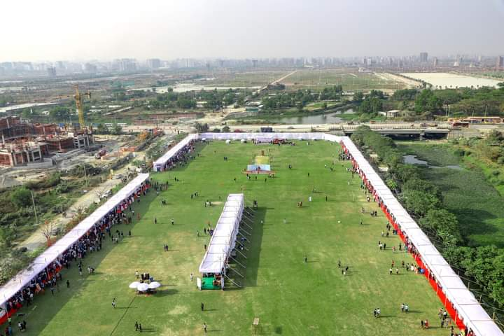
Existing System Analysis
Type | Linkedin | bdjobs | Our System
Login | ✓ | ✓ | ✓
Offline Availability | ❌ | ❌ | ✓
Instant Interview | ❌ | ❌ | ✓
Cost | ✓ | ❌ | ❌

Slide 7
FEATURES
1. Login
2. Dashboard
3. User Profile
4. Search
5. Job
6. Post
7. Friend
8. Group
9. Notifications
10. Alumni Network
11. Company Profile
12. Top Job
13. Booth Registration
14. Event Management
15. Messaging
16. About us
17. Help and Support
18. Feedback and Rating

Slide 8
FLOW CHART
Candidate:
Stakeholder:
Log in
↓
Dashboard
↓
Post / Profile / Job
↓
Search
↓
Company Profile
↓
Apply
↓
Submit CV
↓
Exit
Log in ↓ Dashboard ↓ Post / Profile ↓ Response ↓ Select Candidate ↓ Call Candidate ↓ Exit

Slide 9
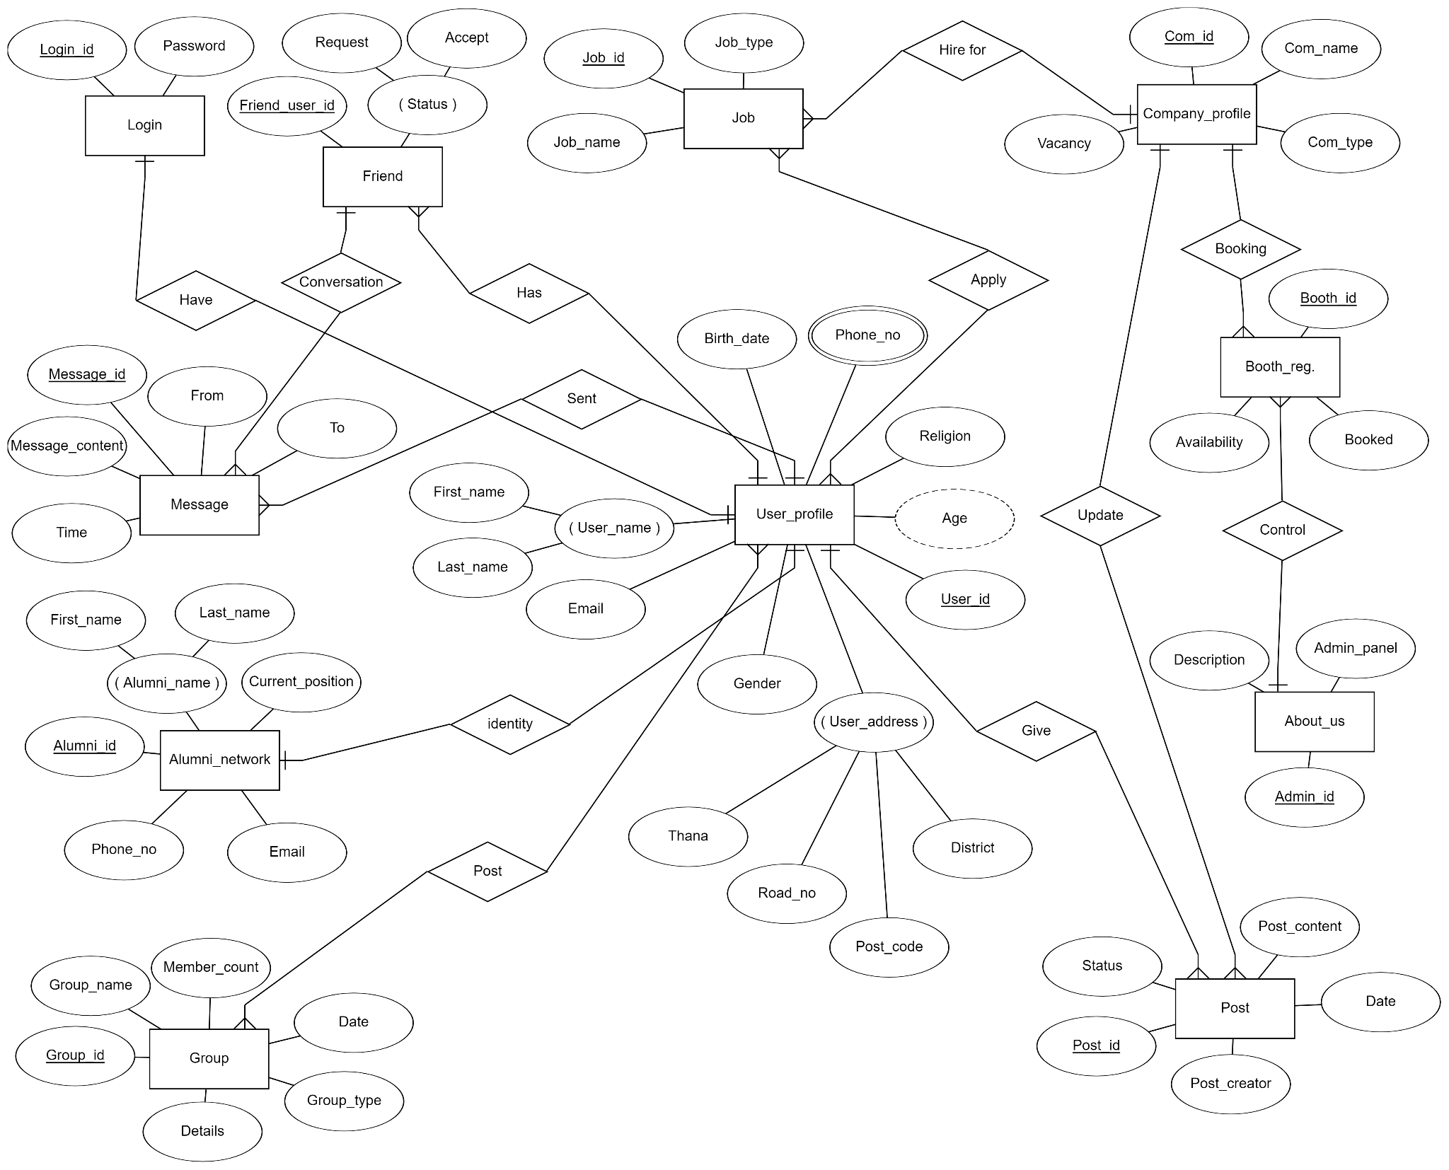
E-R Diagram

Slide 10
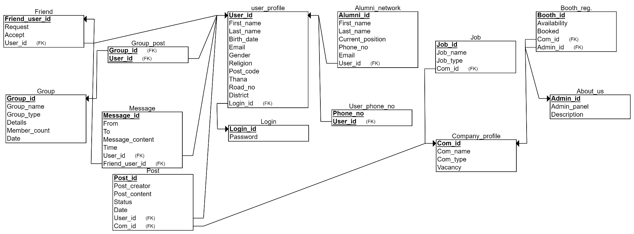
Relational Schema

Slide 11
Task Distribution
Name | Task
Md Shazzad Hossain Jiku | User Profile, Booth Registration, Post, About Us
Ananna Saha | User Profile, Alumni Network, Group, Log in
Md. Ammar Hossain | Company Profile, Job, Friend, Message,Log in

Slide 12
GANTT CHART
Week-1: User Profile, Company Profile
↓
Week-2: Alumni Network, Booth Registration, Job
↓
Week-3: Post, Friend, Group, Message
↓
Week-4: Log in, About Us

Slide 13
THANK YOU

